Slide 1
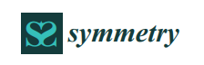
Deep Metric Learning: A Survey
Mahmut KAYA and Hasan Sakir BILGE
蕭卉倫

Slide 2
Outline
Introduction
Metric Learning
Deep Metric Learning
Sample Selection
Loss fuctions for DLM
Conclusions
Example
Reference

Slide 3
Introduction
Metric learning aims to measure the similarity among samples while using an optimal distance metric for learning tasks.
相似?

Slide 4
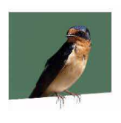
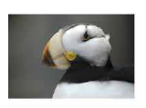
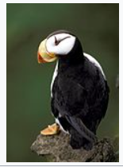
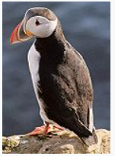
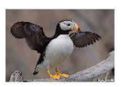
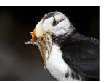
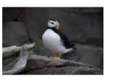
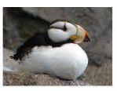
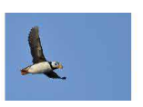
相似?
Notes:
這是角海鸚
北極海鸚

Slide 5
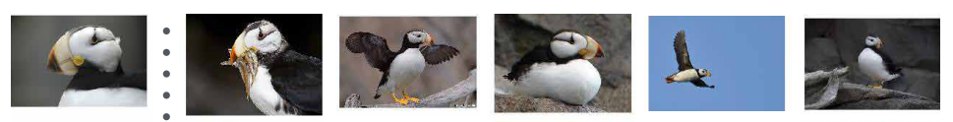
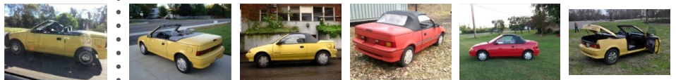
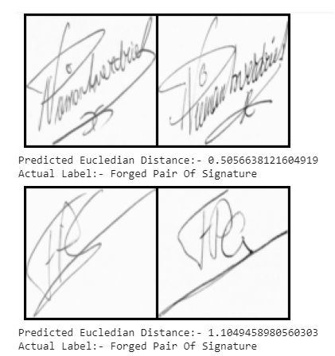
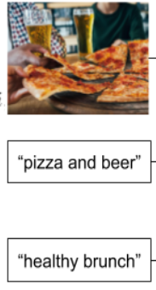


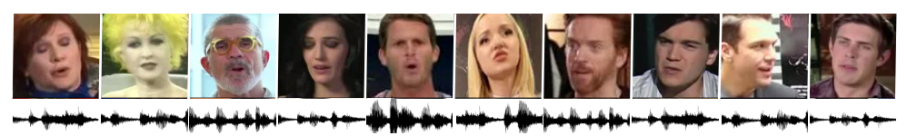
使用的領域
人臉辨識
醫療診斷
入侵檢測系統
語音辨識
文字辨識
物體識別
Notes:
檢索的排名

Slide 6
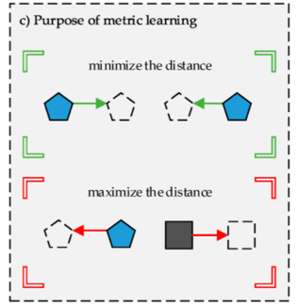
Metric Learning
Metric learning provides a new distance metric by analyzing data.
The main purpose of metric learning is to aim to learn a new metric to reduce the distances between samples of the same class and increase the distances between the samples of different class

Slide 7
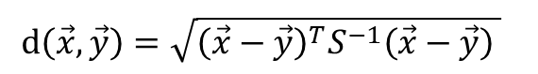
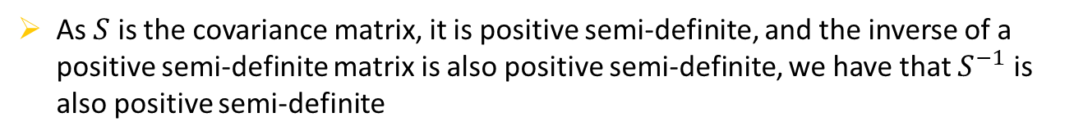
Mahalanobis distance
Mahalanobis distance is an effective multivariate distance metric that measures the distance between a point (vector) and a distribution
Euclidean distance
two-dimensional plane: $d\left(x,y\right)=\sqrt{{\left(x_{1}−y_{1}\right)}^{2}+{\left(x_{2}−y_{2}\right)}^{2}}$
n-dimensional plane: $d\left(x,y\right)=\sqrt{{\left(x_{1}−y_{1}\right)}^{2}+{\left(x_{2}−y_{2}\right)}^{2}+…+{\left(x_{n}−y_{n}\right)}^{2}}$
Mahalanobis distance
$$d\left(\vec{x},\vec{y}\right)=\sqrt{{\left(\vec{x}−\vec{y}\right)}^{T}S^{−1}{\left(\vec{x}−\vec{y}\right)}^{ }}$$
As $S$ is the covariance matrix, it is positive semi-definite, and the inverse of a positive semi-definite matrix is also positive semi-definite, we have that $S^{−1}$ is also positive semi-definite

Slide 8
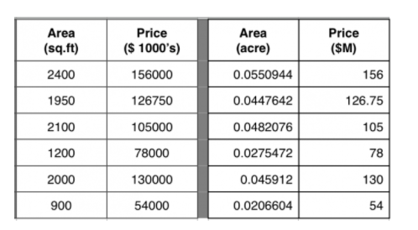
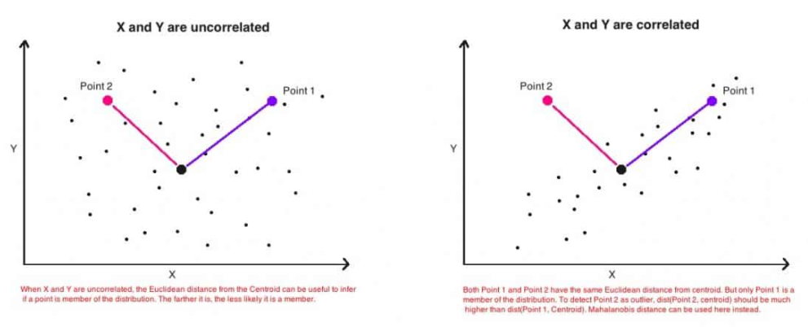
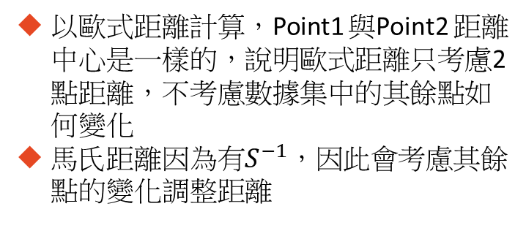
Example1
這兩張表格有相同面積跟價格，只有單位不同
以歐式距離計算，將得到不同的結果
以馬氏距離計算，將得到相同的結果
Example2
X、Y有相關性
以歐式距離計算，Point1 與Point2 距離中心是一樣的，說明歐式距離只考慮2點距離，不考慮數據集中的其餘點如何變化
馬氏距離因為有$S^{−1}$，因此會考慮其餘點的變化調整距離

Slide 9
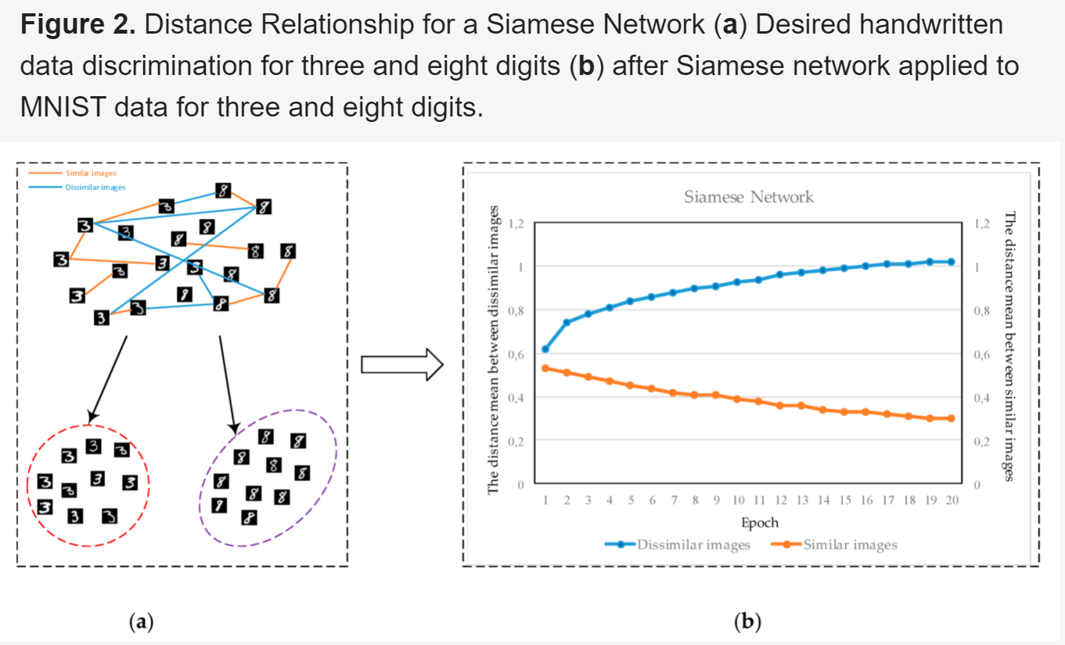
Deep Metric Learning (DML)
Notes:
相似圖像的距離值在每個 epoch 後逐步減小，不相似圖像的距離逐漸增加。

Slide 10
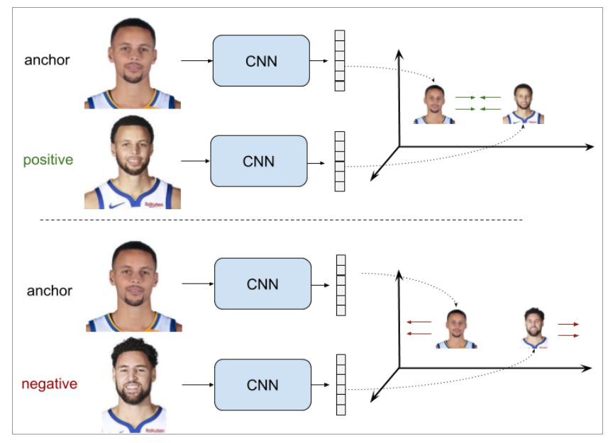
Siamese Network
Shared weight
Shared weight

Slide 11
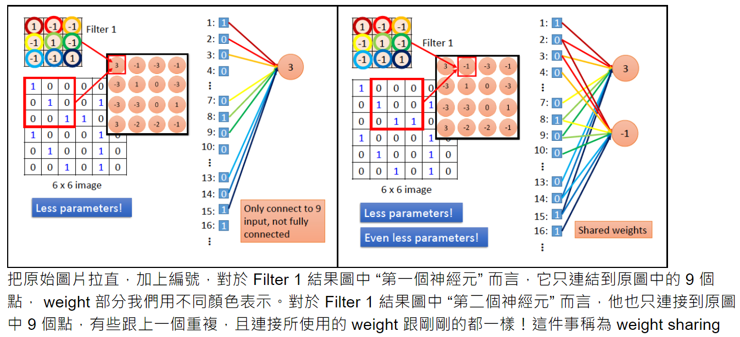
Notes:
因此共享權重。每個過濾器沿圖像滑動，並應用於圖像的不同部分。圖像的值因位置而異，但過濾器的權重（即與圖像相乘的數字）保持不變。因此，許多輸出元素由相同的過濾器權重產生，因此稱為“共享權重”。

Slide 12
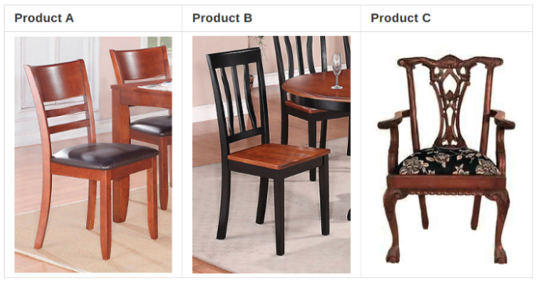
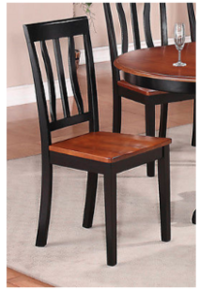
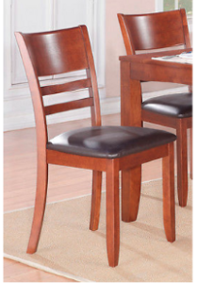
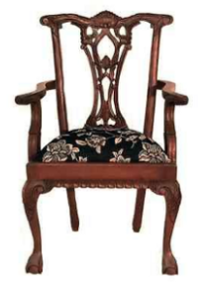
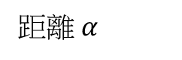
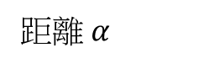
距離 $α$
距離 $α$
Notes:
設置恆定的邊距 α

Slide 13
Notes:
設置恆定的邊距 α

Slide 14
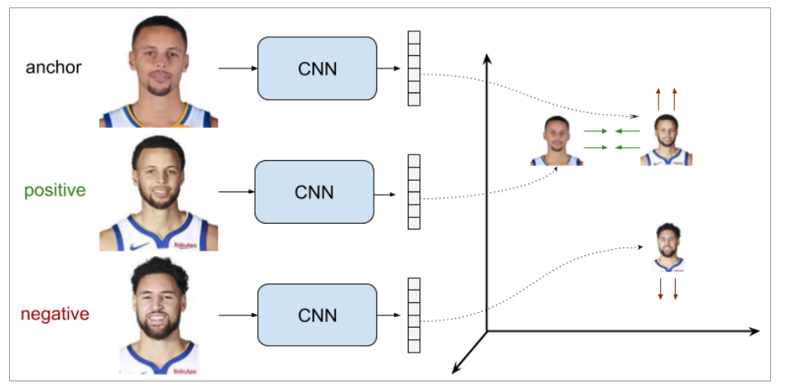
Triplet Network
Shared weight
Shared weight

Slide 15
Sample Selection
Deep metric learning consists of three main parts, which are informative input samples, the structure of the network model, and a metric loss function.
Siamese Network
Simo-Serra et al. (2015) emphasized that the learning process could be slowed down and negatively affected after the network reached an acceptable performance level.
To address this problem, more discriminative models were obtained while using hard negative mining.
Triplet Network
It was observed that some easy triplets had no effect in updating a model due to their poor discriminative power. These triplets cause a waste of time and resources.
It is very convenient to use informative sample triplets, and more feasible train models with a better sample strategy could be provided instead of selecting random samples.

Slide 16
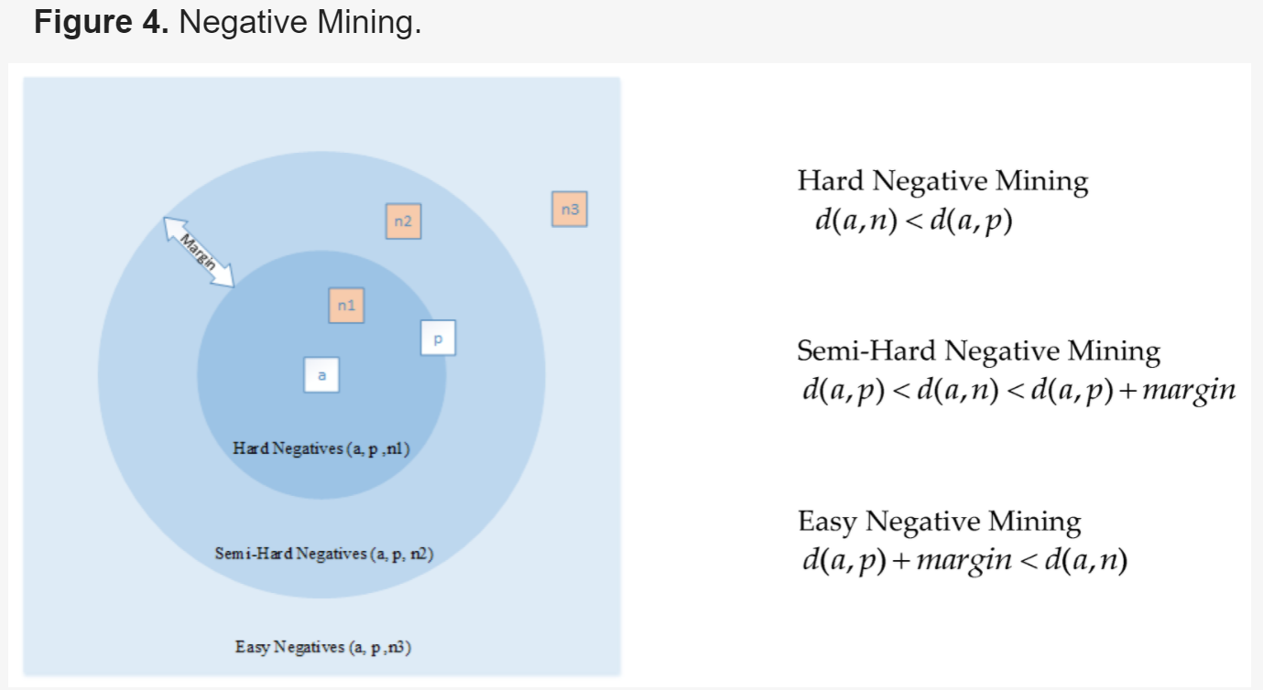
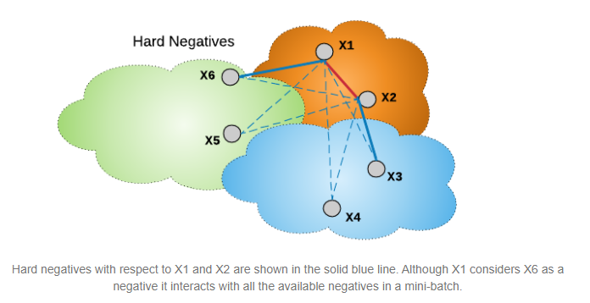
Semi Hard Negative
Easy Negative

Slide 17
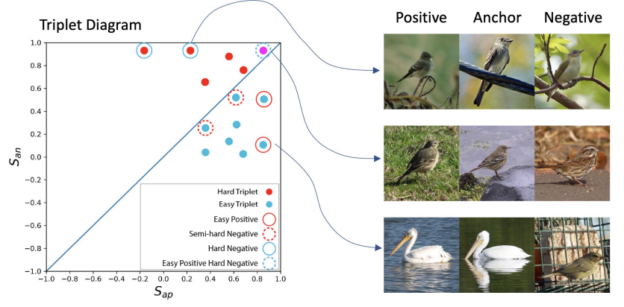
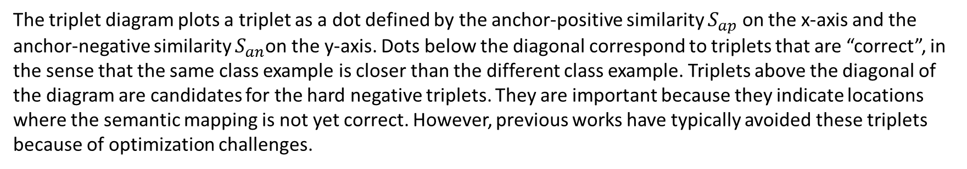
The triplet diagram plots a triplet as a dot defined by the anchor-positive similarity $S_{ap}$ on the x-axis and the anchor-negative similarity $S_{an}$on the y-axis. Dots below the diagonal correspond to triplets that are “correct”, in the sense that the same class example is closer than the different class example. Triplets above the diagonal of the diagram are candidates for the hard negative triplets. They are important because they indicate locations where the semantic mapping is not yet correct. However, previous works have typically avoided these triplets because of optimization challenges.

Slide 18
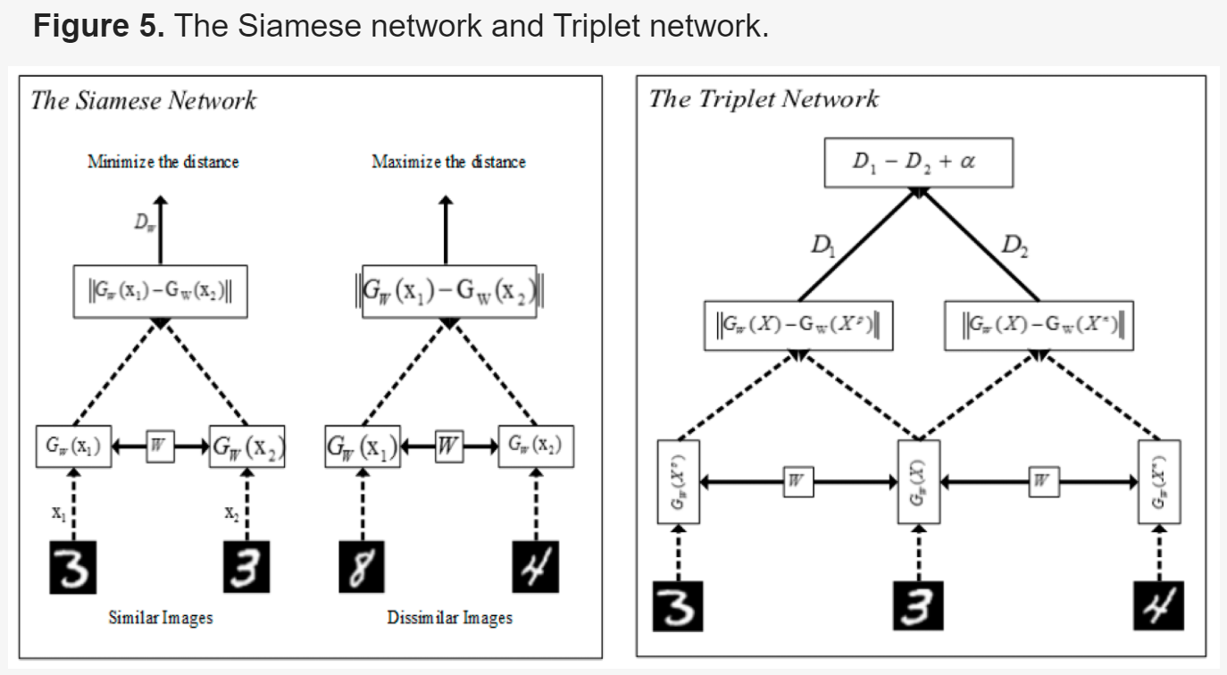
Loss Fuctions for DLM

Slide 19
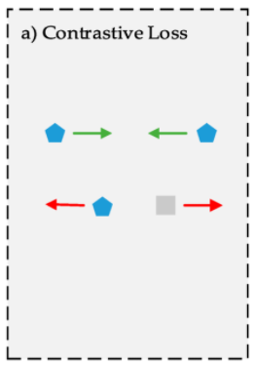
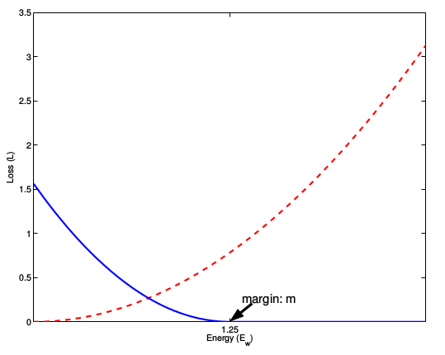
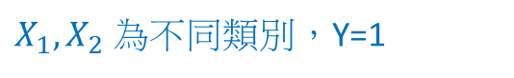
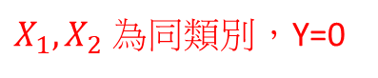
Contrastive loss (Siamese Network)
Let $X_{1}$and $X_{2}$ be a pair of inputs in the training set.
Distance for a pair of input samples
$$D_{W}\left(X_{1},X_{2}\right)={\left\|G_{w}\left(X_{1}\right)−G_{W}(X_{2})\right\|}_{2}$$
where $G_{w}\left(X_{1}\right)$ and $G_{W}(X_{2}$) are generated as a new representation of
a pair of input samples.
Contrastive loss
$$L_{Contrastive}=\left(1−Y\right)\frac{1}{2}{\left(D_{w}\right)}^{2}+\left(Y\right)\frac{1}{2}{\left\{max⁡(0,m−D_{W})\right\}}^{2}$$
$X_{1},X_{2}$ 為同類別，Y=0
$X_{1},X_{2}$ 為不同類別，Y=1
where $Y$ is the label value, $m$ is margin value in $L_{Contrastive}.$
Notes:
則把其loss看做為 0 （即不相似的特徵離的很遠，其 loss 應該是很低的；而對於相似的特徵反而離的很遠，我們就需要增加其 loss， 從而不斷更新成對樣本的匹配程度）

Slide 20
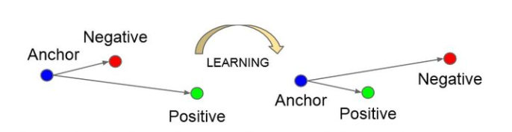
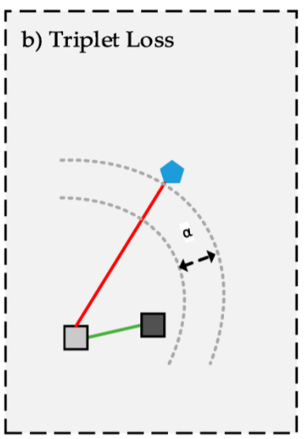
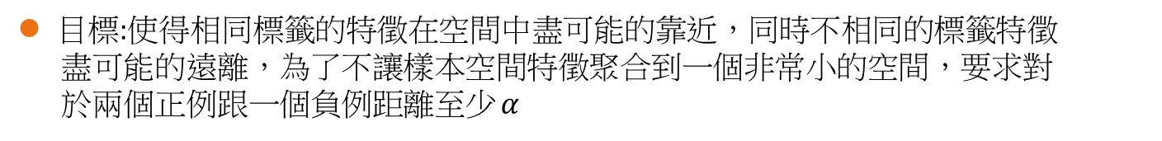
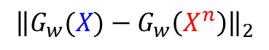
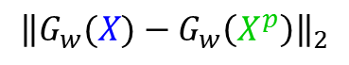
Triplet loss (Triplet network)
$${\left\|G_{w}(X)−G_{w}\left(X^{p}\right)\right\|}_{2}$$
定義: 最小化 Anchor 與 positive samples 之間的距離
最小化 Anchor 與 negative samples 之間的距離
$${\left\|G_{w}(X)−G_{w}\left(X^{n}\right)\right\|}_{2}$$
目標:使得相同標籤的特徵在空間中盡可能的靠近，同時不相同的標籤特徵
盡可能的遠離，為了不讓樣本空間特徵聚合到一個非常小的空間，要求對
於兩個正例跟一個負例距離至少 $α$
${\left\|G_{w}(X)−G_{w}\left(X^{p}\right)\right\|}_{2}+α<$ ${\left\|G_{w}(X)−G_{w}\left(X^{n}\right)\right\|}_{2}$
Triplet loss
$$L_{Triplet}=max⁡(0,{\left\|G_{w}\left(X\right)−G_{w}\left(X^{p}\right)\right\|}_{2}−{\left\|G_{w}\left(X\right)−G_{w}\left(X^{n}\right)\right\|}_{2}+α)$$

Slide 21
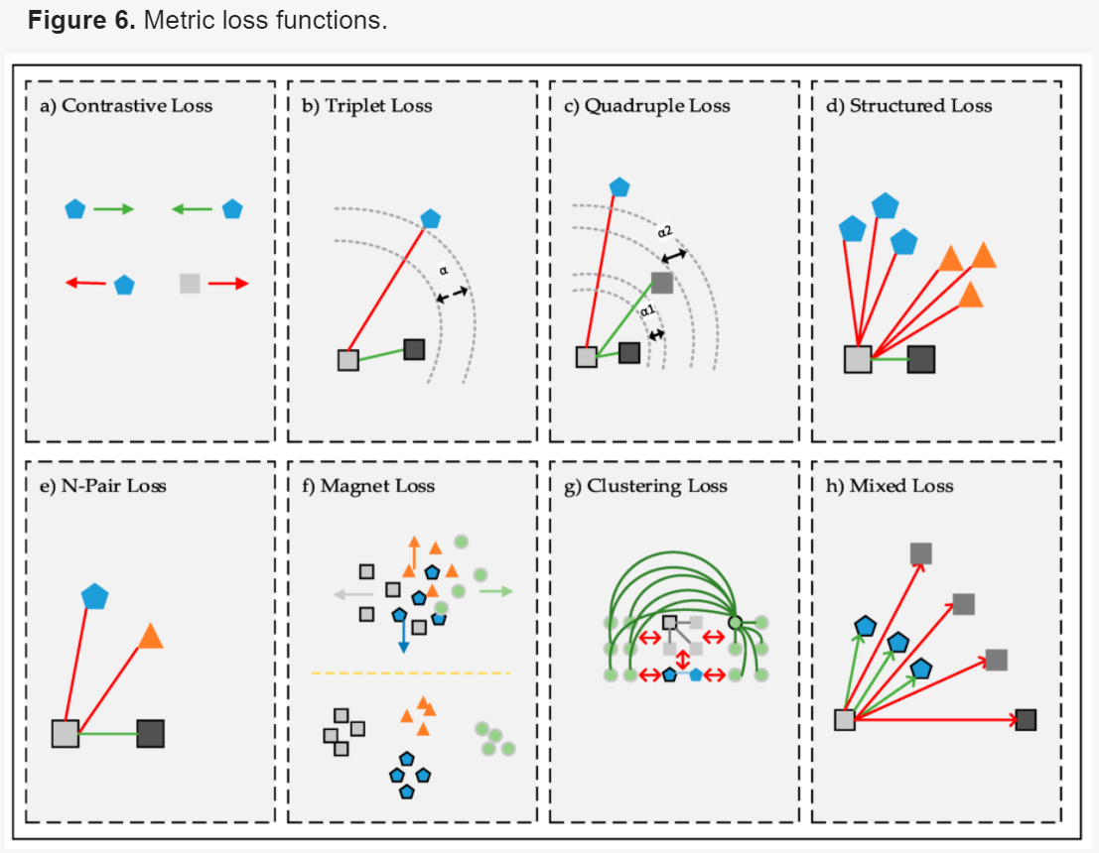
Notes:
Contrastive loss 讓相似得距離越近，不相似的越遠

Slide 22
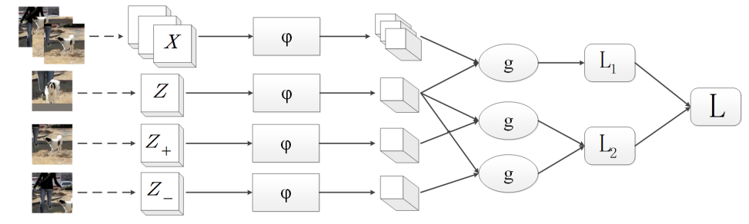
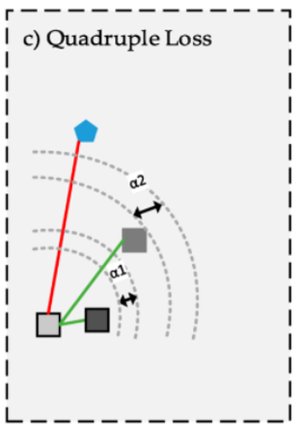
Quadruple Loss
The structure of a quadruplet network. x, z, z+, z− are different inputs of four shared branch networks respectively corresponding to instances, exemplar, positive and negative branches. φ represents a convolution network with shared weights. g is a function of similarity metric. L1, L2, and L are loss functions. Note that the L1 loss is derived from exemplar and instances, while L2 is from exemplar, positive instance and negative instance. L loss is the weighted combination of these two losses. We further give more images in tracking task for illustration at the left of this figure
$$L_{Quadruple}=max⁡(0,{\left\|G_{w}\left(X\right)−G_{w}\left(X^{p}\right)\right\|}_{2}−{\left\|G_{w}\left(X\right)−G_{w}\left(X^{s}\right)\right\|}_{2}+α_{1})$$
$+max⁡(0,{\left\|G_{w}\left(X\right)−G_{w}\left(X^{s}\right)\right\|}_{2}−{\left\|G_{w}\left(X\right)−G_{w}\left(X^{n}\right)\right\|}_{2}+α_{2})$
Notes:
一部分就是正常的triplet loss，这部分loss能够让模型区分出正样本对和负样本对之间的相对距离。
另一部分是正样本对和其他任意负样本对之前的相对距离。这一部分约束可以理解成最小的类间距离都要大于类内距离，不管这些样本对是否有同样的anchor。即不仅要要求 ，还需要

Slide 23
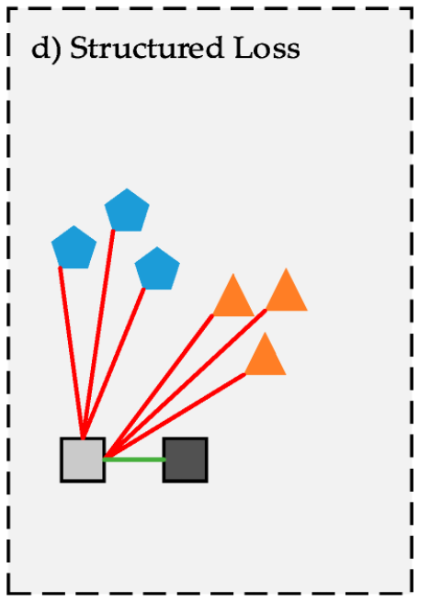
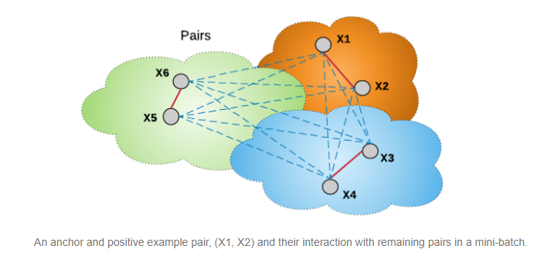
Structured Loss

Slide 24


N-Pairs Loss

Slide 25

Agular Loss
Notes:
著重在計算絕對距離

Slide 26
Conclusions
Three main parts: samples, model, and metric loss function.
Additionally, poor sampling strategy might cause convergence to slow down. To address these problems, hard or semi-hard negative mining strategy provides substantial contributions to obtain informative input samples.
In future studies, optimally determining the margin value and finding different sampling strategies will make a significant contribution to the success of a network
The layers, parameters, shared weights, and network model used in deep learning are another important part to be optimized.
The last main part is a metric loss function, which significantly determines the performance of the network
Notes:
主要在

Slide 27

Example- Triplet Network
Datast: Mnist
將資料分成
anchors、
positive、
negative

Slide 28


Slide 29


Slide 30


Loss function & margin
執行

Slide 31





0.02941642
0.80201435
0.15659472
0.39720362
0.02362314
0.24268748
0.18541086
0.09696817

Slide 32
Reference
https://zh.wikipedia.org/wiki/%E6%B5%B7%E9%B8%9A
https://openaccess.thecvf.com/content_cvpr_2016/supplemental/Song_Deep_Metric_Learning_2016_CVPR_supplemental.pdf
https://github.com/aspamers/siamese
Siamese Network & Triplet network
https://zhuanlan.zhihu.com/p/55254100
https://peaceful0907.medium.com/few-shot-learning-siamese-network-73bc0a98c6fa
https://towardsdatascience.com/the-why-and-the-how-of-deep-metric-learning-e70e16e199c0
https://blog.csdn.net/autocyz/article/details/53149760
https://iter01.com/581069.html
https://gombru.github.io/2019/04/03/ranking_loss/
https://towardsdatascience.com/a-friendly-introduction-to-siamese-networks-85ab17522942
https://medium.com/slyce-engineering/digging-deeper-into-metric-learning-loss-functions-29d89edfe200
http://violin-tao.blogspot.com/2017/07/ml-convolutional-neural-network-cnn.html

Slide 33
Mahalanobis distance metric
https://www.machinelearningplus.com/statistics/mahalanobis-distance/
https://en.wikipedia.org/wiki/Mahalanobis_distance
paper
Dong, Xingping, et al. "Quadruplet network with one-shot learning for fast visual object tracking." IEEE Transactions on Image Processing 28,3516-3527
Kaya, M., and Bilge, H. Ş. (2019). Deep metric learning: A survey. Symmetry 11, 1066.
Example
https://zhangruochi.com/Create-a-Siamese-Network-with-Triplet-Loss-in-Keras/2020/08/11/
https://github.com/KevinMusgrave/pytorch-metric-learning
https://zhuanlan.zhihu.com/p/369884080
https://towardsdatascience.com/a-friendly-introduction-to-siamese-networks-85ab17522942

Slide 34

The end

